Slide 1

Lecture Presentation
Chapter 9 Molecular Geometry and Bonding Theories

Slide 2
Writing Lewis Structures (Covalent Molecules)
Sum the valence electrons from all atoms, taking into account overall charge.
If it is an anion, add one electron for each negative charge.
If it is a cation, subtract one electron for each positive charge.
PCl₃
Keep track of the electrons:
5 + 3(7) = 26

Slide 3
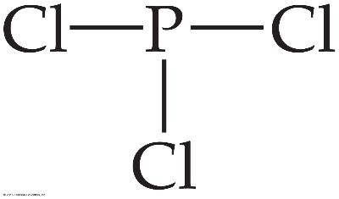
Writing Lewis Structures
Write the symbols for the atoms, show which atoms are attached to which, and connect them with a single bond (a line representing two electrons).
Keep track of the electrons:
26 − 6 = 20

Slide 4
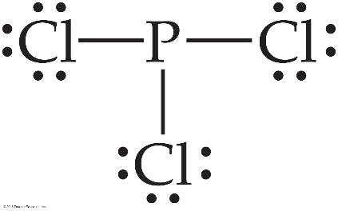
Writing Lewis Structures
Complete the octets around all atoms bonded to the central atom.
Keep track of the electrons:
26 − 6 = 20; 20 − 18 = 2

Slide 5
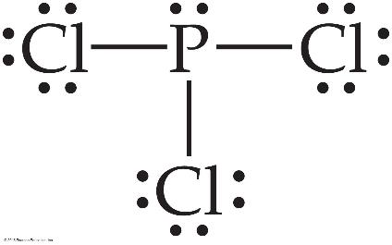
Writing Lewis Structures
Place any leftover electrons on the central atom.
Keep track of the electrons:
26 − 6 = 20; 20 − 18 = 2; 2 − 2 = 0

Slide 6
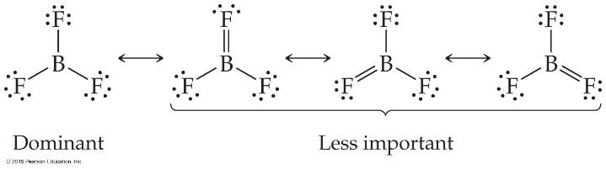
Fewer Than Eight Electrons
Elements in the second period before carbon can make stable compounds with fewer than eight electrons.
Consider BF₃:
Giving boron a filled octet places a negative charge on the boron and a positive charge on fluorine.
This would not be an accurate picture of the distribution of electrons in BF₃.

Slide 7
Example
From the figure on the last slide
CH₄(g) + Cl₂(g) ⎯⎯→ CH₃Cl(g) + HCl(g)
In this example, one C—H bond and one Cl—Cl bond are broken; one C—Cl and one H—Cl bond are formed.

Slide 8
Answer
ΔH = [D(C—H) + D(Cl—Cl)] − [D(C—Cl) +
D(H—Cl)]
= [(413 kJ) + (242 kJ)] − [(328 kJ) + (431 kJ)]
= (655 kJ) − (759 kJ)
= −104 kJ

Slide 9
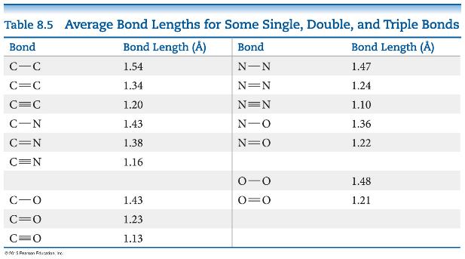
Bond Enthalpy and Bond Length
We can also measure an average bond length for different bond types.
As the number of bonds between two atoms increases, the bond length decreases.

Slide 10
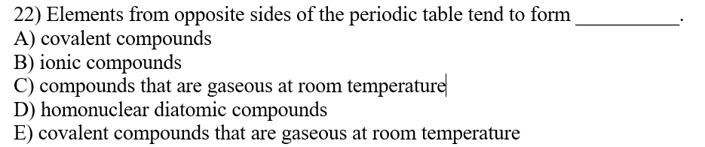
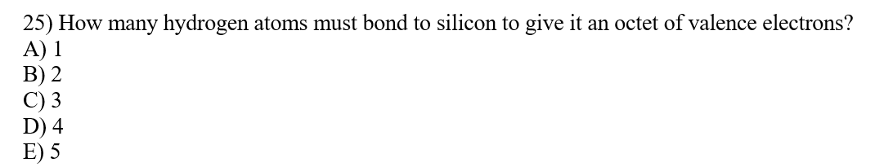
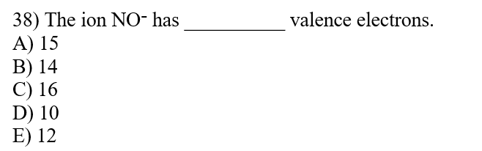

Slide 11
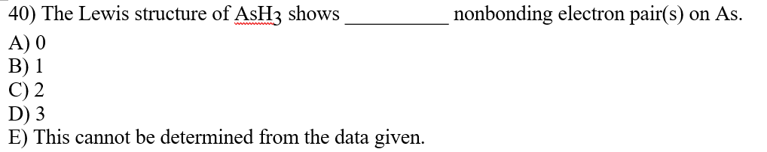
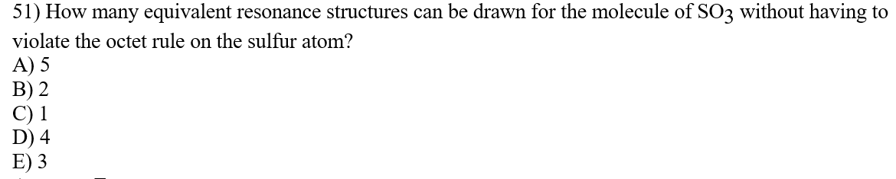
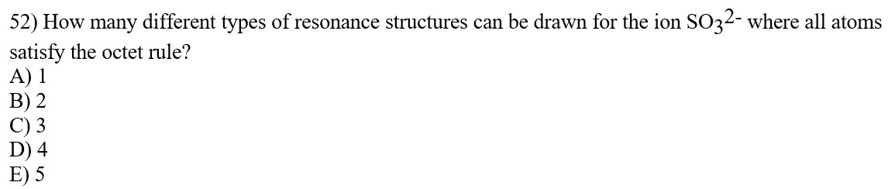

Slide 12
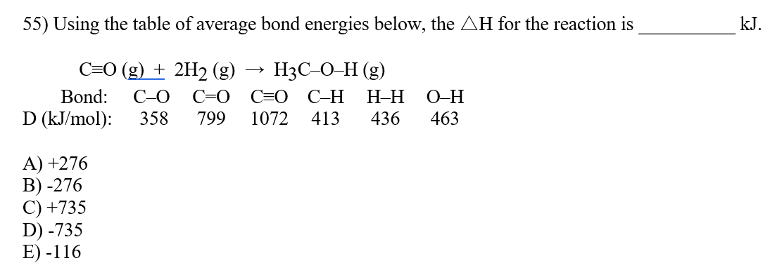

Slide 13
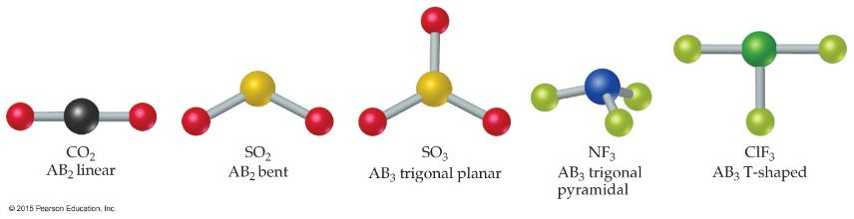
Molecular Shapes
Lewis Structures show bonding and lone pairs, but do not denote shape.
However, we use Lewis Structures to help us determine shapes.
Here we see some common shapes for molecules with two or three atoms connected to a central atom.

Slide 14
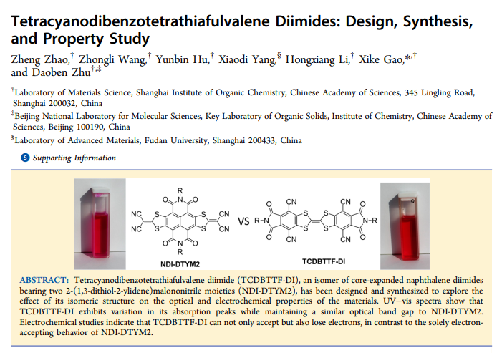

Slide 15
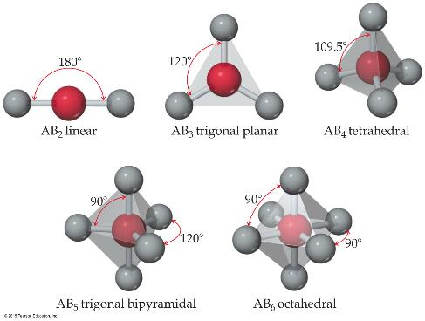
What Determines the Shape of a Molecule?
Simply put, electron pairs, whether they be bonding or nonbonding, repel each other.
By assuming the electron pairs are placed as far as possible from each other, we can predict the shape of the molecule.
This is the Valence-Shell Electron-Pair Repulsion (VSEPR) model.

Slide 16
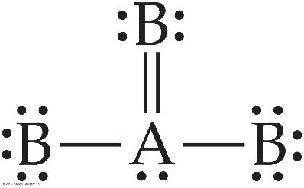
Electron Domains
We can refer to the directions to which electrons point as electron domains. This is true whether there is one or more electron pairs pointing in that direction.
The central atom in this molecule, A, has four electron domains.

Slide 17
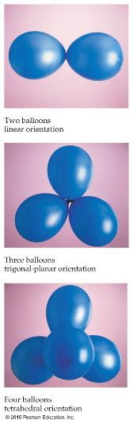
Valence-Shell Electron-Pair Repulsion (VSEPR) Model
“The best arrangement of a given number of electron domains is the one that minimizes the repulsions among them.”
(The balloon analogy in the figure to the left demonstrates the maximum distances, which minimize repulsions.)

Slide 18
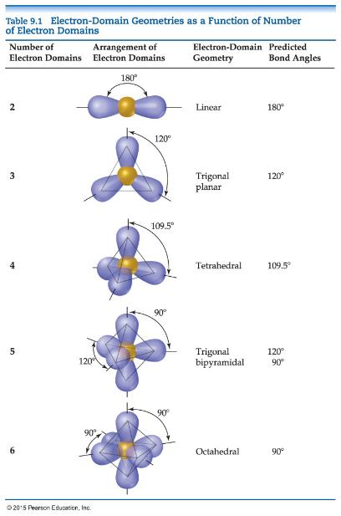
Electron-Domain Geometries
The Table shows the electron-domain geometries for two through six electron domains around a central atom.
To determine the electron-domain geometry, count the total number of lone pairs, single, double, and triple bonds on the central atom.

Slide 19
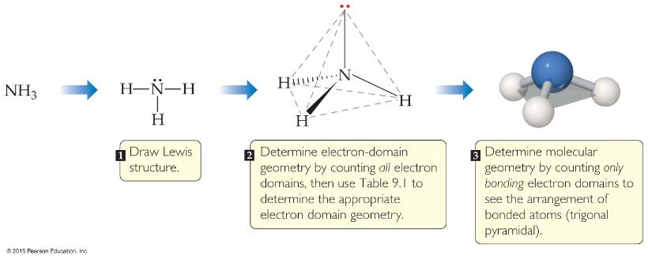
Molecular Geometries
Once you have determined the electron-domain geometry, use the arrangement of the bonded atoms to determine the molecular geometry.
Tables 9.2 and 9.3 show the potential molecular geometries. We will look at each electron domain to see what molecular geometries are possible.

Slide 20
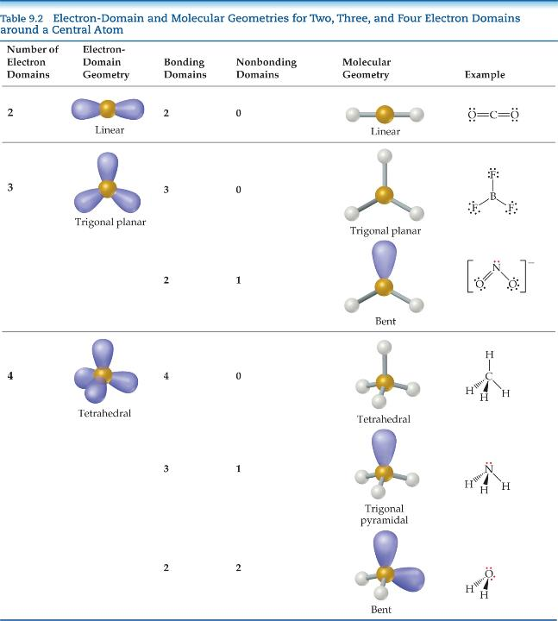
Linear Electron Domain
In the linear domain, there is only one molecular geometry: linear.
NOTE: If there are only two atoms in the molecule, the molecule will be linear no matter what the electron domain is.

Slide 21
Trigonal Planar Electron Domain
There are two molecular geometries:
trigonal planar, if all electron domains are bonding, and
bent, if one of the domains is a nonbonding pair.

Slide 22
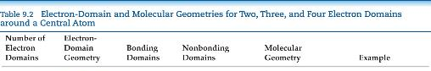
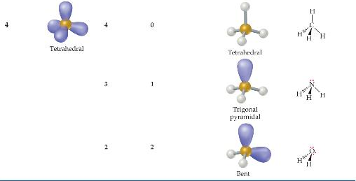
Tetrahedral Electron Domain
There are three molecular geometries:
tetrahedral, if all are bonding pairs,
trigonal pyramidal, if one is a nonbonding pair, and
bent, if there are two nonbonding pairs.

Slide 23
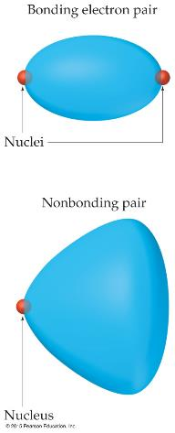
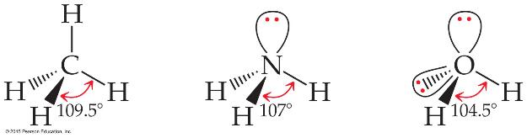
Nonbonding Pairs and Bond Angle
Nonbonding pairs are physically larger than bonding pairs.
Therefore, their repulsions are greater; this tends to compress bond angles.

Slide 24
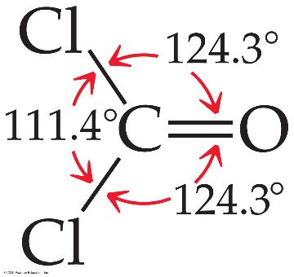
Multiple Bonds and Bond Angles
Double and triple bonds have larger electron domains than single bonds.
They exert a greater repulsive force than single bonds, making their bond angles greater.

Slide 25
Expanding beyond the Octet Rule
Remember that some elements can break the octet rule and make more than four bonds (or have more than four electron domains).
The result is two more possible electron domains: five = trigonal bipyramidal; six = octahedral (as was seen in the slide on electron-domain geometries).

Slide 26
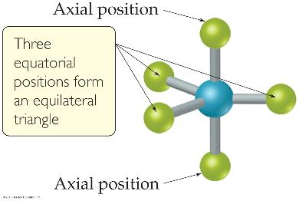
Trigonal Bipyramidal Electron Domain
There are two distinct positions in this geometry:
Axial
Equatorial
Lone pairs occupy equatorial positions.

Slide 27
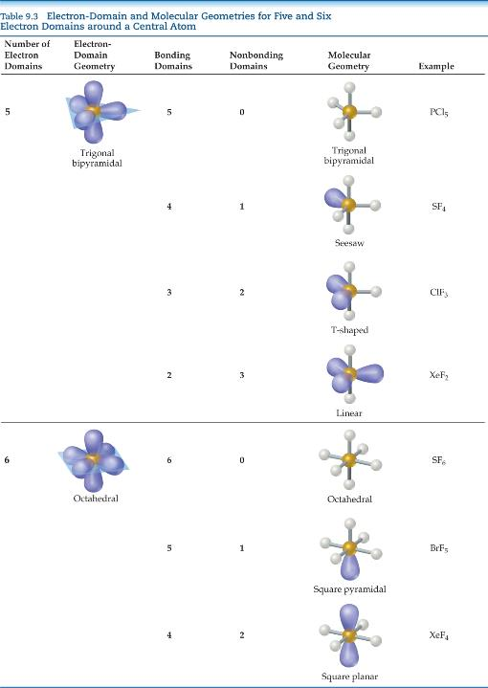
Trigonal Bipyramidal Electron Domain
There are four distinct molecular geometries in this domain:
Trigonal bipyramidal
Seesaw
T-shaped
Linear

Slide 28

Octahedral Electron Domain
All positions are equivalent in the octahedral domain.
There are three molecular geometries:
Octahedral
Square pyramidal
Square planar

Slide 29
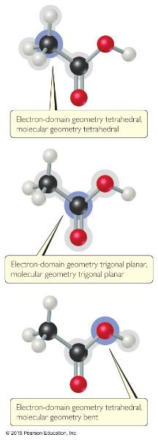
Shapes of Larger Molecules
For larger molecules, look at the geometry about each atom rather than the molecule as a whole.

Slide 30
Polarity of Molecules
Ask yourself:
COVALENT or IONIC? If COVALENT:
Are the BONDS polar?
NO: The molecule is NONPOLAR!
YES: Continue—Do the AVERAGE position of δ+ and δ– coincide?
YES: The molecule is NONPOLAR.
NO: The molecule is POLAR.
NOTE: Different atoms attached to the central atom have different polarity of bonds.

Slide 31
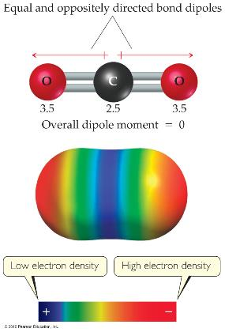
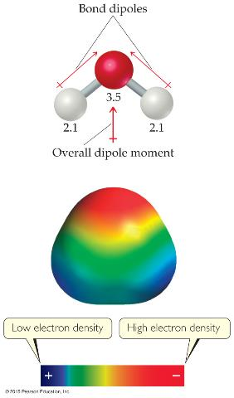
Comparison of the Polarity of Two Molecules
A NONPOLAR molecule
A POLAR molecule

Slide 32
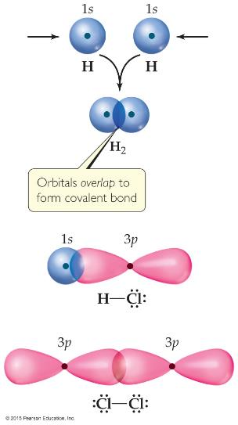
Valence-Bond Theory
In Valence-Bond Theory, electrons of two atoms begin to occupy the same space.
This is called “overlap” of orbitals.
The sharing of space between two electrons of opposite spin results in a covalent bond.
Notes:
Start here 6/14/10

Slide 33
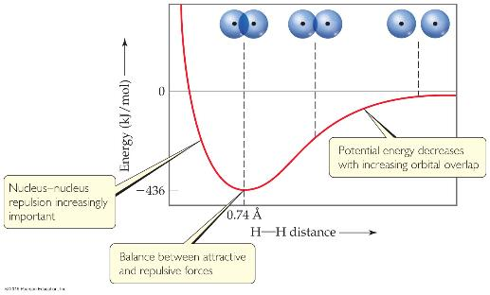
Overlap and Bonding
Increased overlap brings the electrons and nuclei closer together until a balance is reached between the like charge repulsions and the electron-nucleus attraction.
Atoms can’t get too close because the internuclear repulsions get too great.

Slide 34
VSEPR and Hybrid Orbitals
VSEPR predicts shapes of molecules very well.
How does that fit with orbitals?
Let’s use H₂O as an example:
If we draw the best Lewis structure to assign VSEPR, it becomes bent.
If we look at oxygen, its electron configuration is 1s²2s²2p⁴. If it shares two electrons to fill its valence shell, they should be in 2p.
Wouldn’t that make the angle 90°?
Why is it 104.5°?

Slide 35
Hybrid Orbitals
Hybrid orbitals form by “mixing” of atomic orbitals to create new orbitals of equal energy, called degenerate orbitals.
When two orbitals “mix” they create two orbitals; when three orbitals mix, they create three orbitals; etc.

Slide 36



Be—sp hybridization
When we look at the orbital diagram for beryllium (Be), we see that there are only paired electrons in full sub-levels.
Be makes electron deficient compounds with two bonds for Be. Why? sp hybridization (mixing of one s orbital and one p orbital)

Slide 37
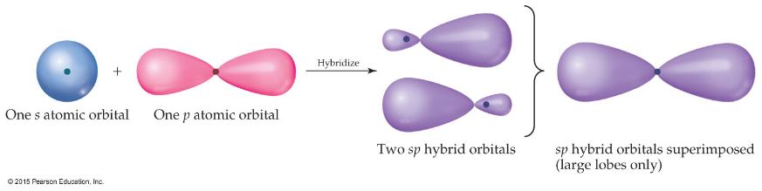
sp Orbitals
Mixing the s and p orbitals yields two degenerate orbitals that are hybrids of the two orbitals.
These sp hybrid orbitals have two lobes like a p orbital.
One of the lobes is larger and more rounded, as is the s orbital.

Slide 38
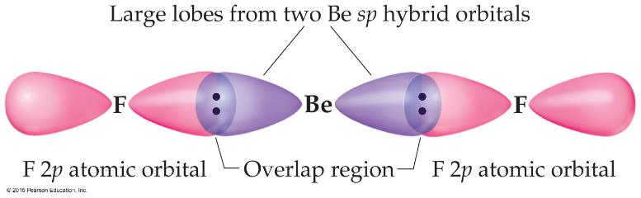
Position of sp Orbitals
These two degenerate orbitals would align themselves 180° from each other.
This is consistent with the observed geometry of Be compounds (like BeF₂) and VSEPR: linear.

Slide 39
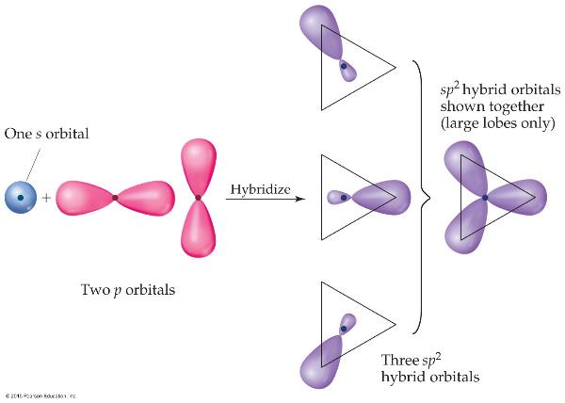
Boron—Three Electron Domains Gives sp² Hybridization
Using a similar model for boron leads to three degenerate sp² orbitals.

Slide 40
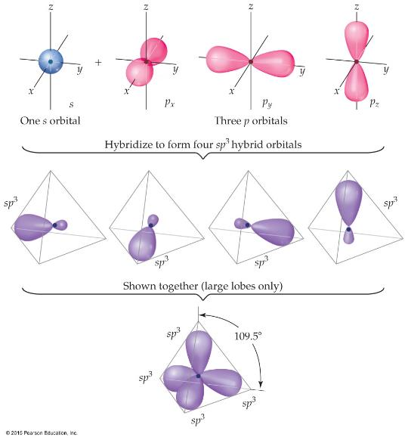
Carbon: sp³ Hybridization
With carbon, we get four degenerate sp³ orbitals.

Slide 41
Hypervalent Molecules
The elements which have more than an octet
Valence-Bond model would use d orbitals to make more than four bonds.
This view works for period 3 and below.
Theoretical studies suggest that the energy needed would be too great for this.
A more detailed bonding view is needed than we will use in this course.

Slide 42
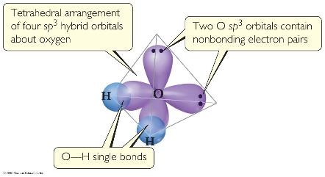
What Happens with Water?
We started this discussion with H₂O and the angle question: Why is it 104.5° instead of 90°?
Oxygen has two bonds and two lone pairs—four electron domains.
The result is sp³ hybridization!

Slide 43
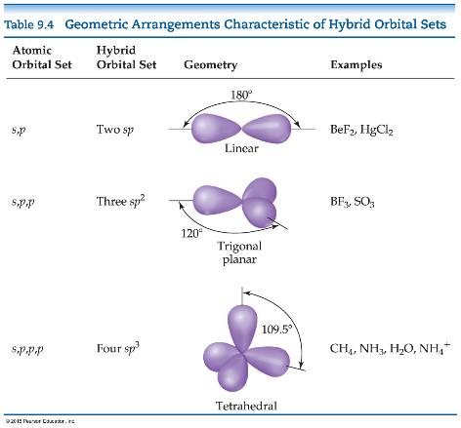
Hybrid Orbital Summary
Draw the Lewis structure.
Use VSEPR to determine the electron-domain geometry.
Specify the hybrid orbitals needed to accommodate these electron pairs.

Slide 44
Types of Bonds
How does a double or triple bond form?
It can’t, if we only use hybridized orbitals.
However, if we use the orbitals which are not hybridized, we can have a “side-ways” overlap.
Two types of bonds:
Sigma (σ) bond
Pi (π) bond

Slide 45
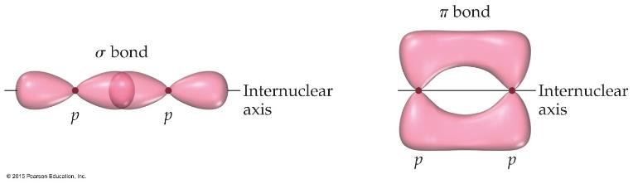
Sigma (σ) and Pi (π) Bonds
Sigma bonds are characterized by
head-to-head overlap.
cylindrical symmetry of electron density about the internuclear axis.
Pi bonds are characterized by
side-to-side overlap.
electron density above and below the internuclear axis.

Slide 46
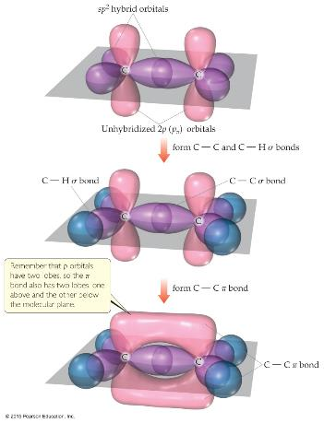
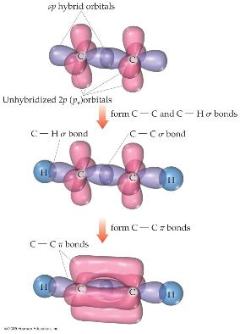
Bonding in Molecules
Single bonds are always σ-bonds.
Multiple bonds have one σ-bond, all other bonds are π-bonds.

Slide 47
Localized or Delocalized Electrons
Bonding electrons (σ or π) that are specifically shared between two atoms are called localized electrons.
In many molecules, we can’t describe all electrons that way (resonance); the other electrons (shared by multiple atoms) are called delocalized electrons.

Slide 48
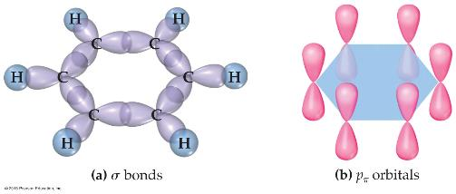
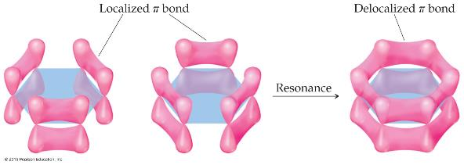
Benzene
The organic molecule benzene (C₆H₆) has six σ-bonds and a p orbital on each C atom, which form delocalized bonds using one electron from each p orbital.

Slide 49
Molecular Orbital (MO) Theory
Wave properties are used to describe the energy of the electrons in a molecule.
Molecular orbitals have many characteristics like atomic orbitals:
maximum of two electrons per orbital
Electrons in the same orbital have opposite spin.
Definite energy of orbital
Can visualize electron density by a contour diagram

Slide 50
More on MO Theory
They differ from atomic orbitals because they represent the entire molecule, not a single atom.
Whenever two atomic orbitals overlap, two molecular orbitals are formed: one bonding, one antibonding.
Bonding orbitals are constructive combinations of atomic orbitals.
Antibonding orbitals are destructive combinations of atomic orbitals. They have a new feature unseen before: A nodal plane occurs where electron density equals zero.

Slide 51
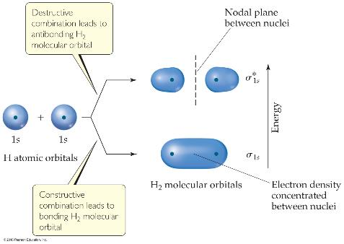
Molecular Orbital (MO) Theory
Whenever there is direct overlap of orbitals, forming a bonding and an antibonding orbital, they are called sigma (σ) molecular orbitals. The antibonding orbital is distinguished with an asterisk as σ*. Here is an example for the formation of a hydrogen molecule from two atoms.
Notes:
Start here 6/16/10

Slide 52
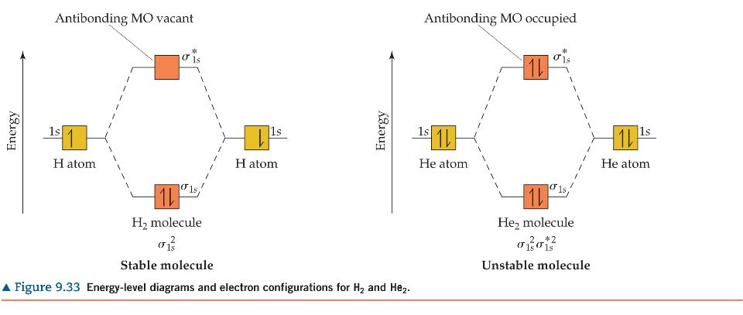
MO Diagram
An energy-level diagram, or MO diagram shows how orbitals from atoms combine to give the molecule.
In H₂ the two electrons go into the bonding molecular orbital (lower in energy).
Bond order = ½(# of bonding electrons – # of antibonding electrons) = ½(2 – 0) = 1 bond

Slide 53
Can He₂ Form? Use MO Diagram and Bond Order to Decide!
Bond Order = ½(2 – 2) = 0 bonds
Therefore, He₂ does not exist.

Slide 54
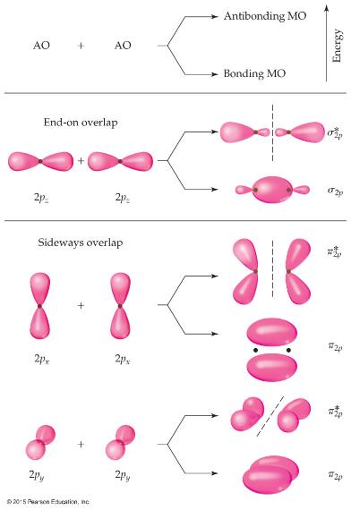
s and p Orbitals Can Interact
For atoms with both s and p orbitals, there are two types of interactions:
The s and the p orbitals that face each other overlap in σ fashion.
The other two sets of p orbitals overlap in π fashion.
These are, again, direct and “side-ways” overlap of orbitals.

Slide 55
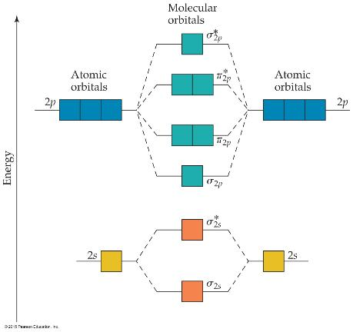
MO Theory
The resulting MO diagram:
There are σ and σ* orbitals from s and p atomic orbitals.
There are π and π* orbitals from p atomic orbitals.
Since direct overlap is stronger, the effect of raising and lowering energy is greater for σ and σ*.

Slide 56
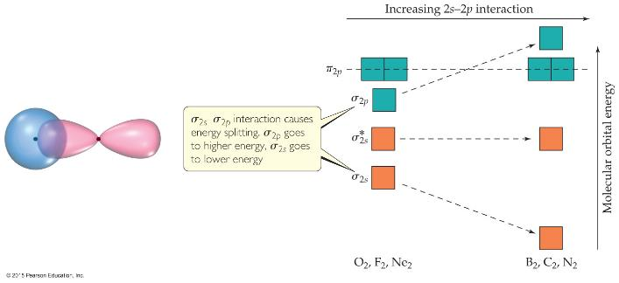
s and p Orbital Interactions
In some cases, s orbitals can interact wit the p_{z} orbitals more than the p_{x} and p_{y} orbitals.
It raises the energy of the p_{z} orbital and lowers the energy of the s orbital.
The p_{x} and p_{y} orbitals are degenerate orbitals.

Slide 57
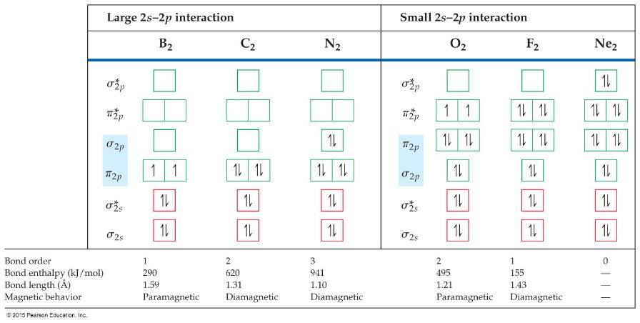
MO Diagrams for Diatomic Molecules of 2nd Period Elements

Slide 58
MO Diagrams and Magnetism
Diamagnetism is the result of all electrons in every orbital being spin paired. These substances are weakly repelled by a magnetic field.
Paramagnetism is the result of the presence of one or more unpaired electrons in an orbital.
Is oxygen (O₂) paramagnetic or diamagnetic? Look back at the MO diagram! It is paramagnetic.

Slide 59
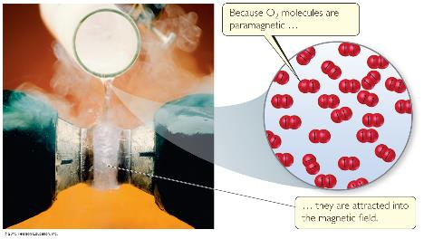
Paramagnetism of Oxygen
Lewis structures would not predict that O₂ is paramagnetic.
The MO diagram clearly shows that O₂ is paramagnetic.
Both show a double bond (bond order = 2).

Slide 60

Heteronuclear Diatomic Molecules
Diatomic molecules can consist of atoms from different elements.
How does a MO diagram reflect differences?
The atomic orbitals have different energy, so the interactions change slightly.
The more electronegative atom has orbitals lower in energy, so the bonding orbitals will more resemble them in energy.

